Slide 1


Unit 4: Lesson 13 Good reads
U ovoj ćemo lekciji:
govoriti o knjigama i čitanju
pročitati tekst o Marku Twainu
napisati osvrt o knjizi

Slide 2
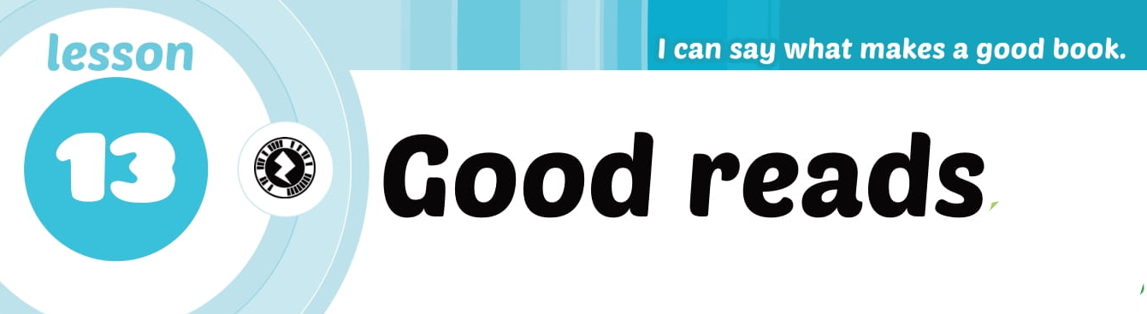


Slide 3

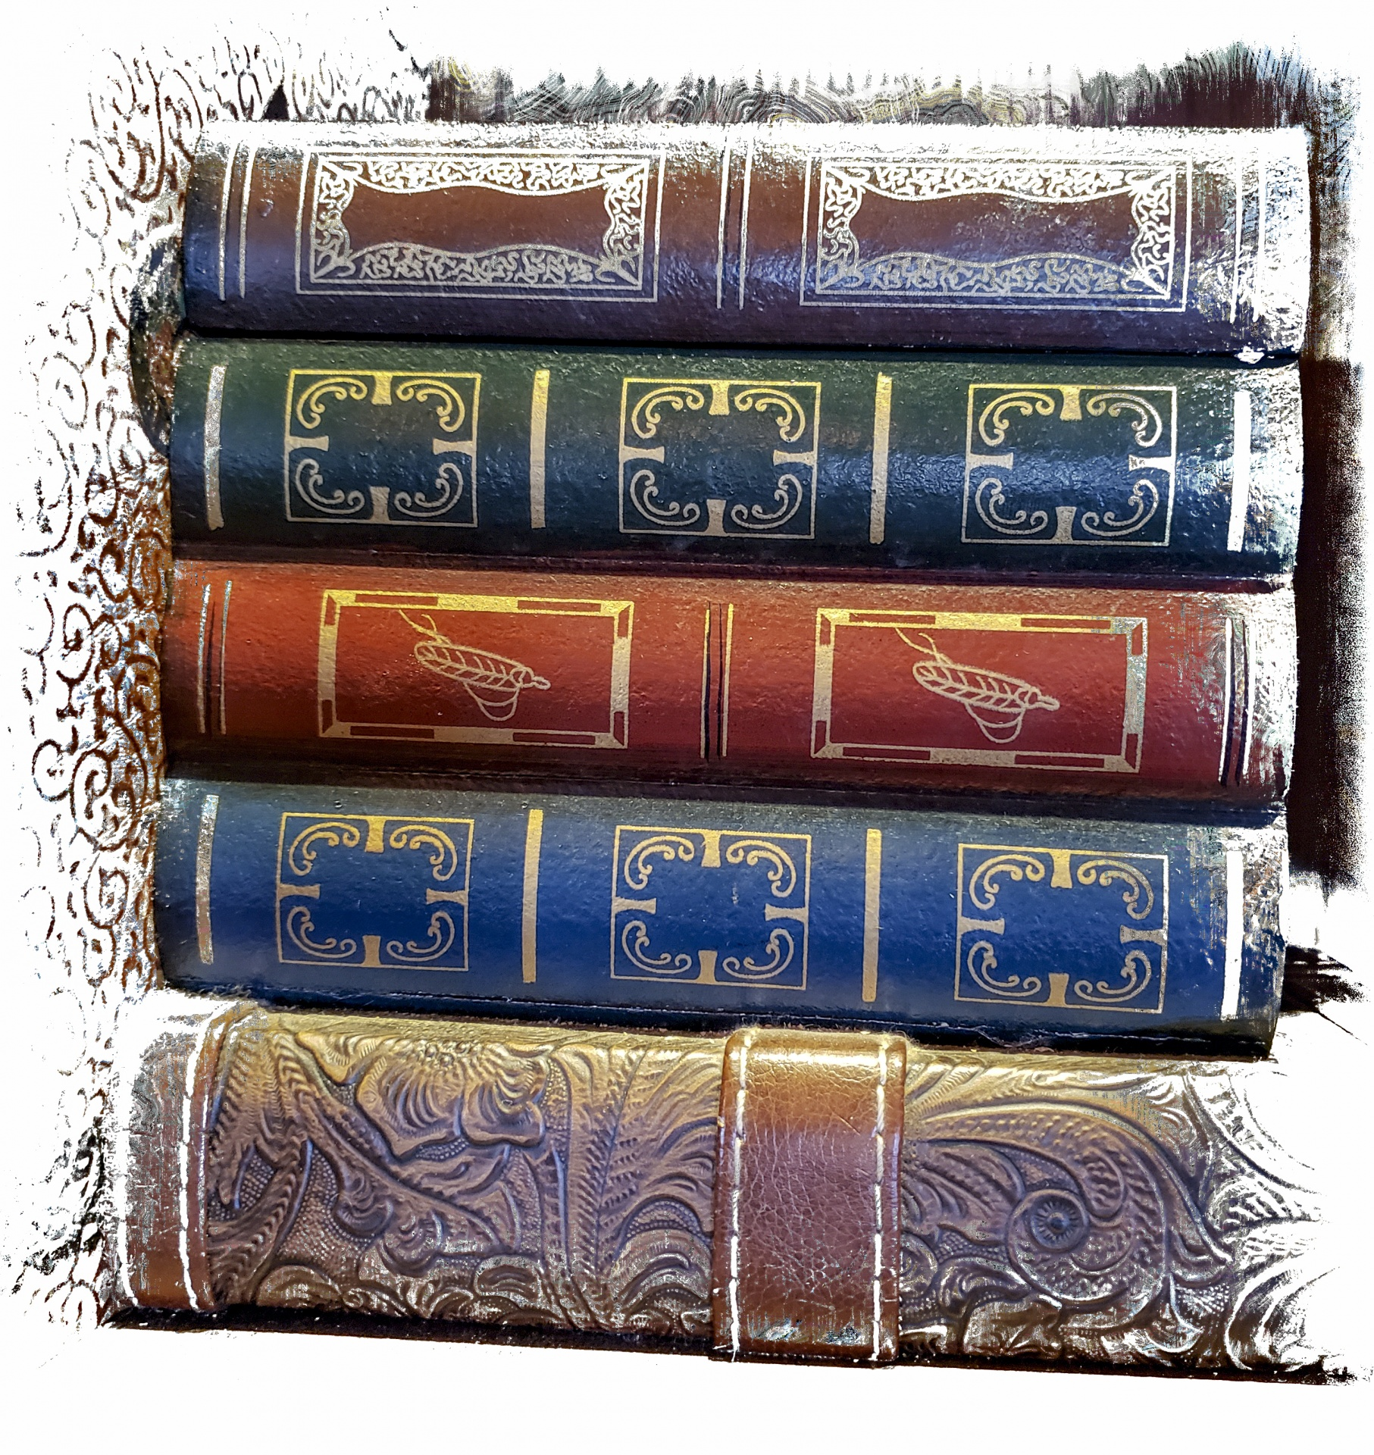
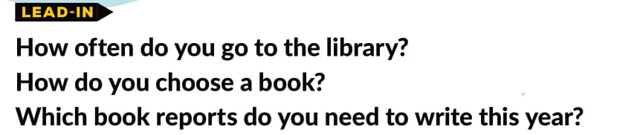
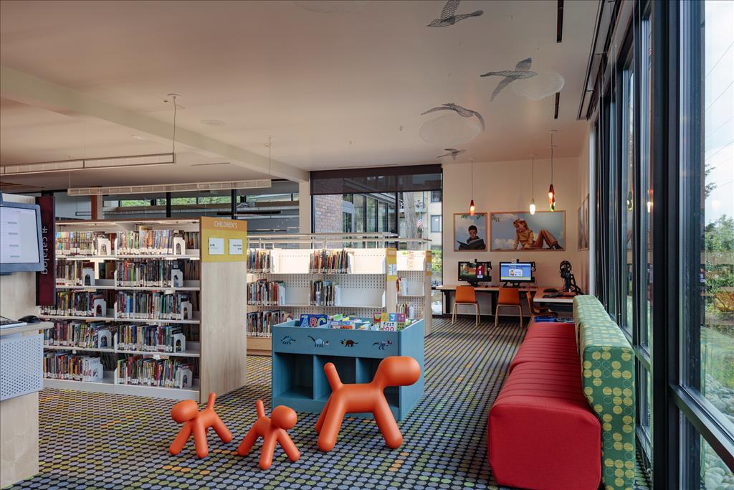

This Photo by Unknown Author is licensed under CC BY

Slide 4


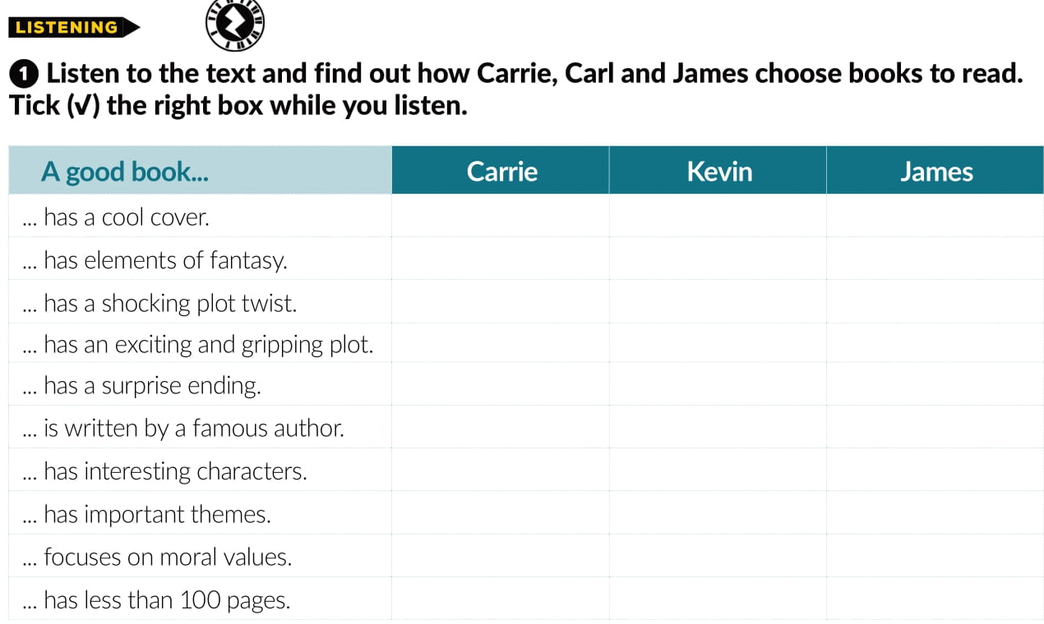


Slide 5
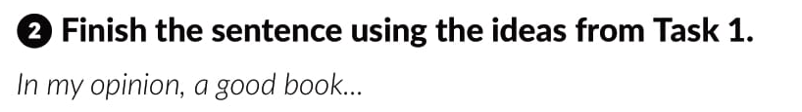
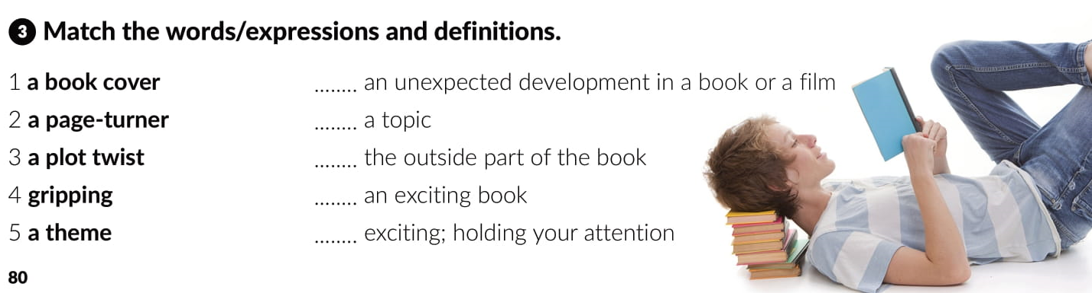
3
5
1
2
4

Slide 6

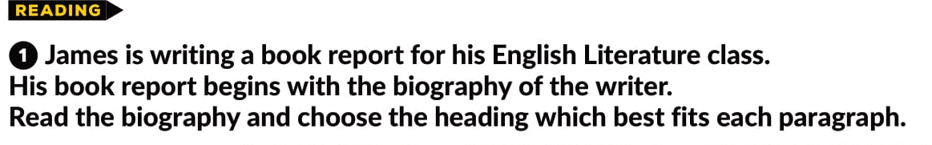
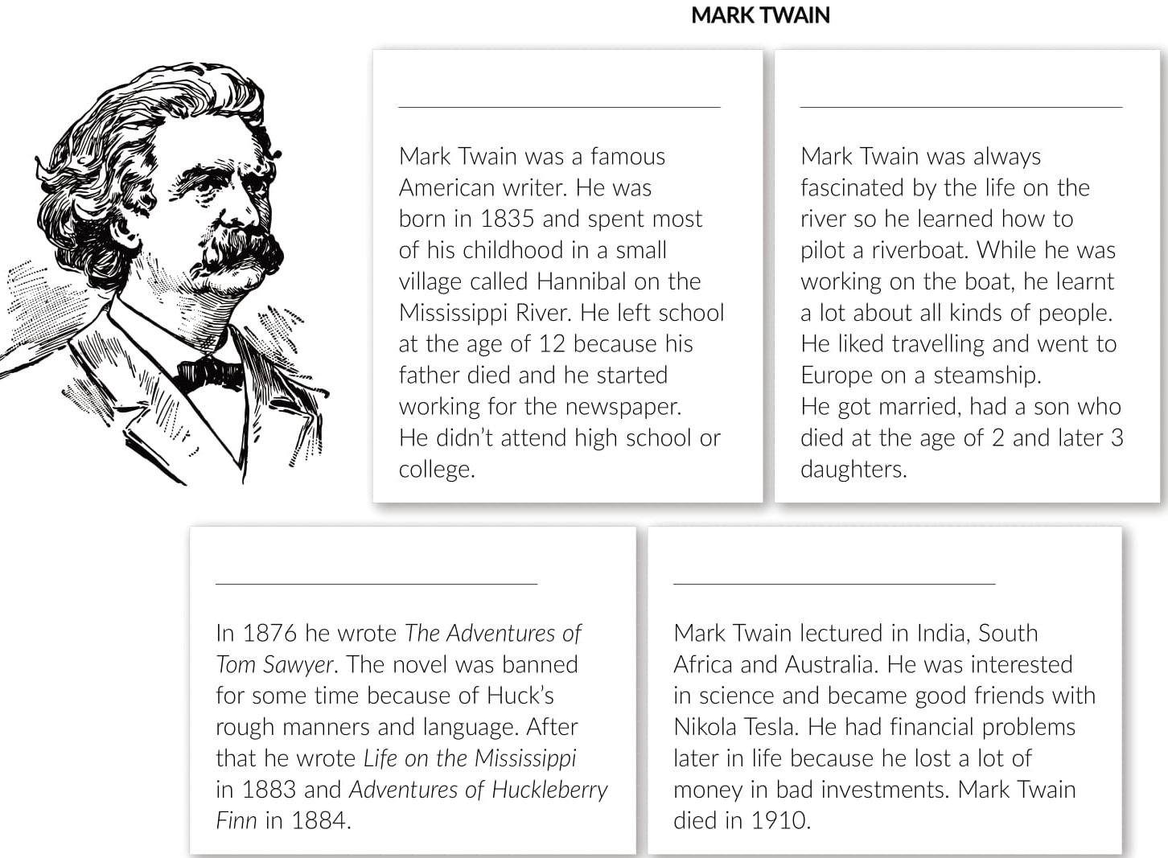





Slide 7
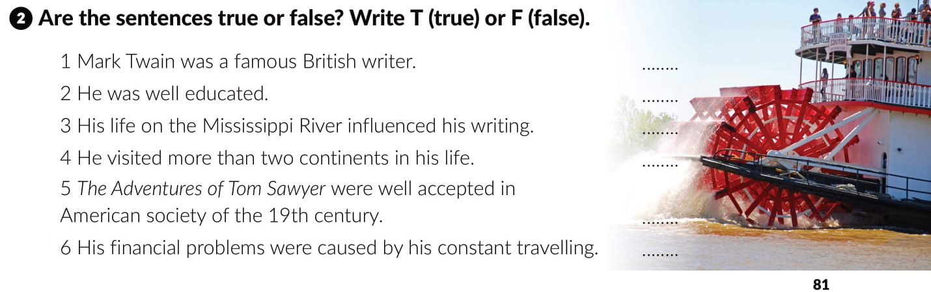
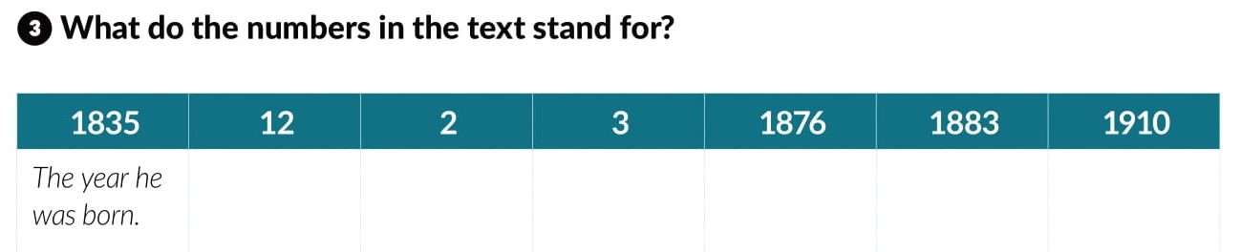
F
F
T
T
F
F
The age he left school.
The age his son died.
The number of daughters he had.
The year he wrote Tom Sawyer.
The year he wrote Life on the Mississippi.
The year
he died.

Slide 8
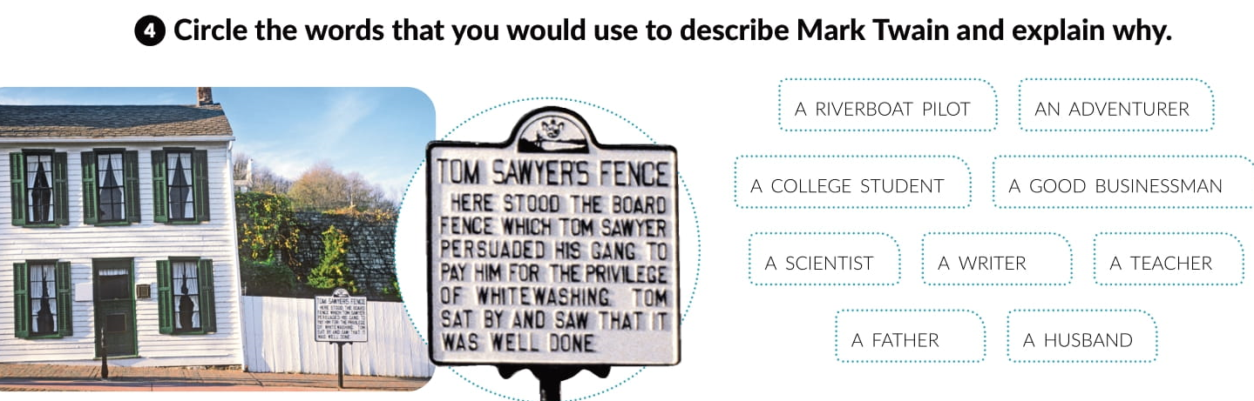

Slide 9
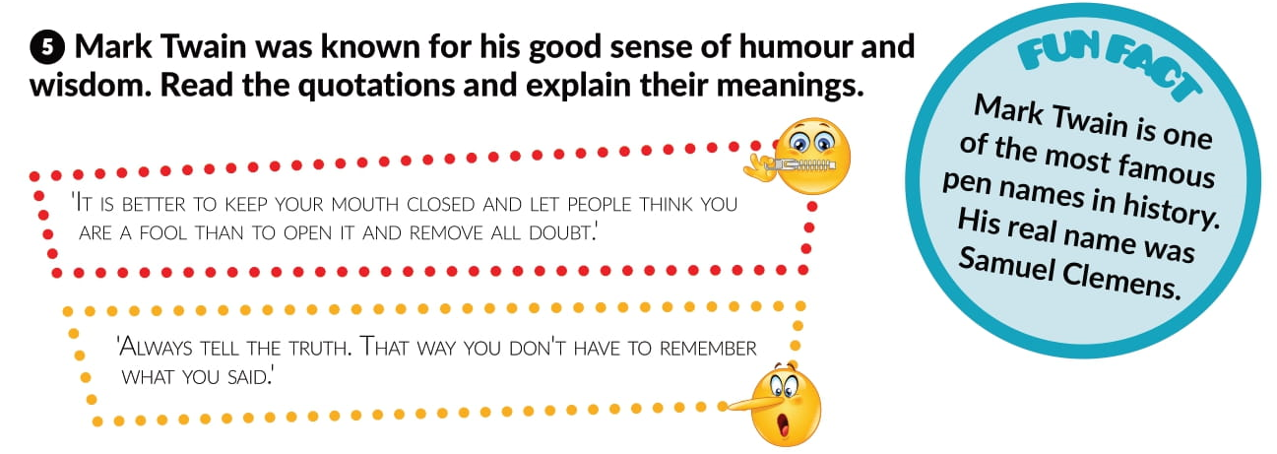

Slide 10
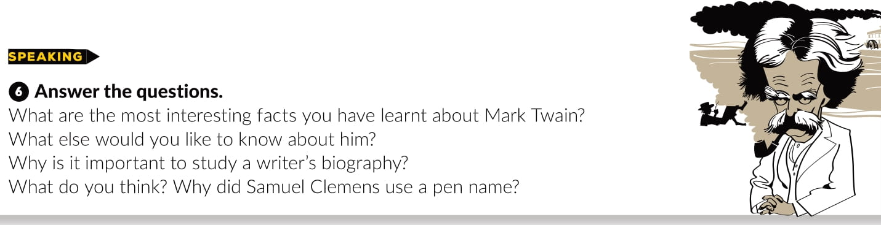
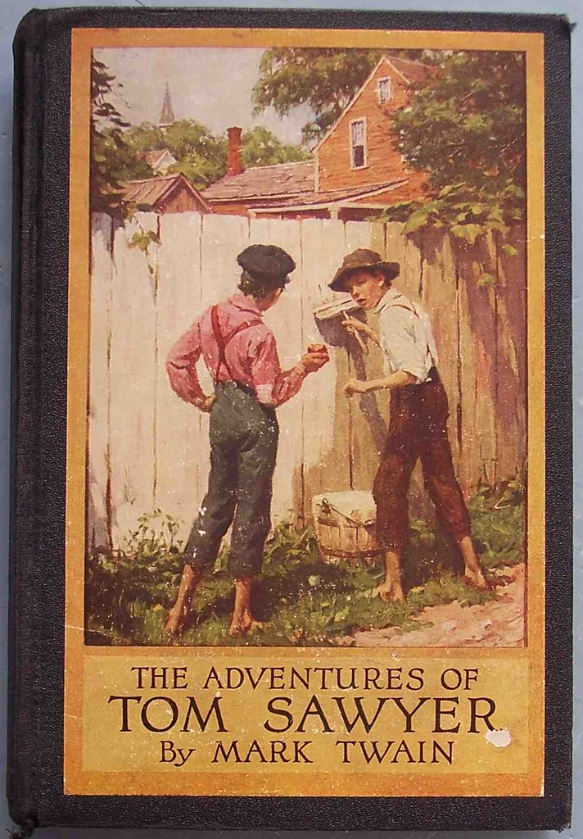
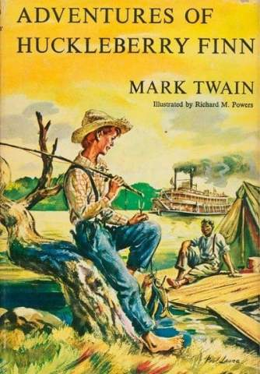
This Photo by Unknown Author is licensed under CC BY
This Photo by Unknown Author is licensed under CC BY-SA

Slide 11
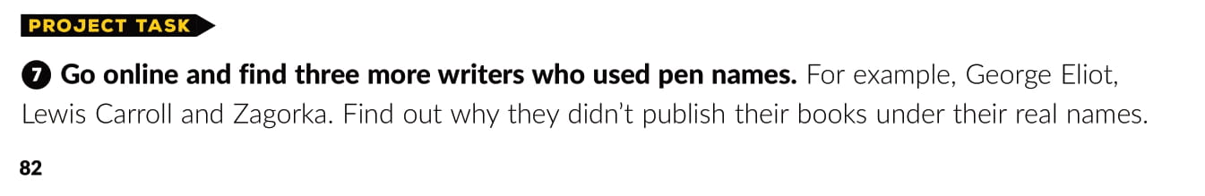



This Photo by Unknown Author is licensed under CC BY-NC-ND

Slide 12

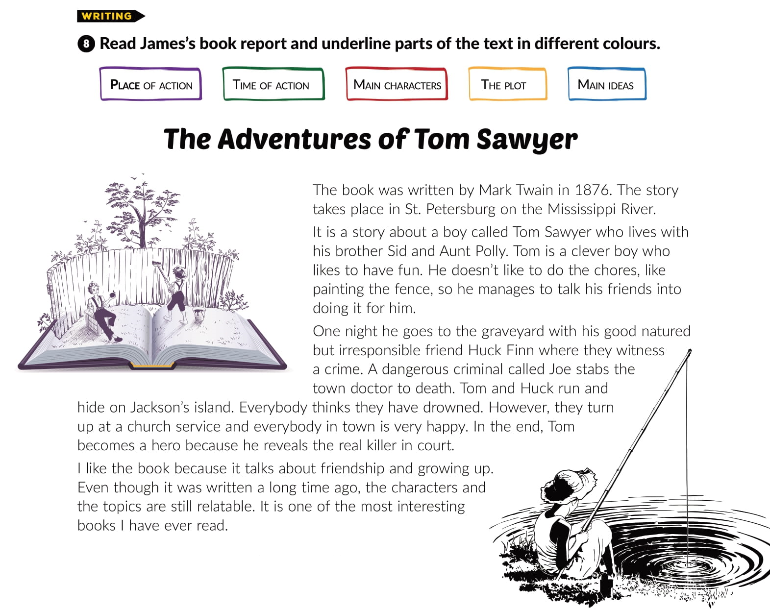

Slide 13

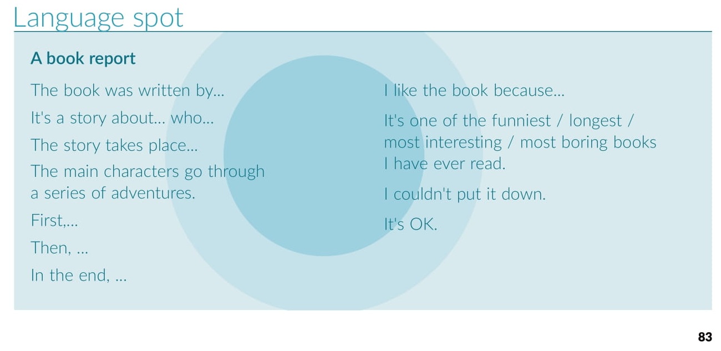

Slide 14
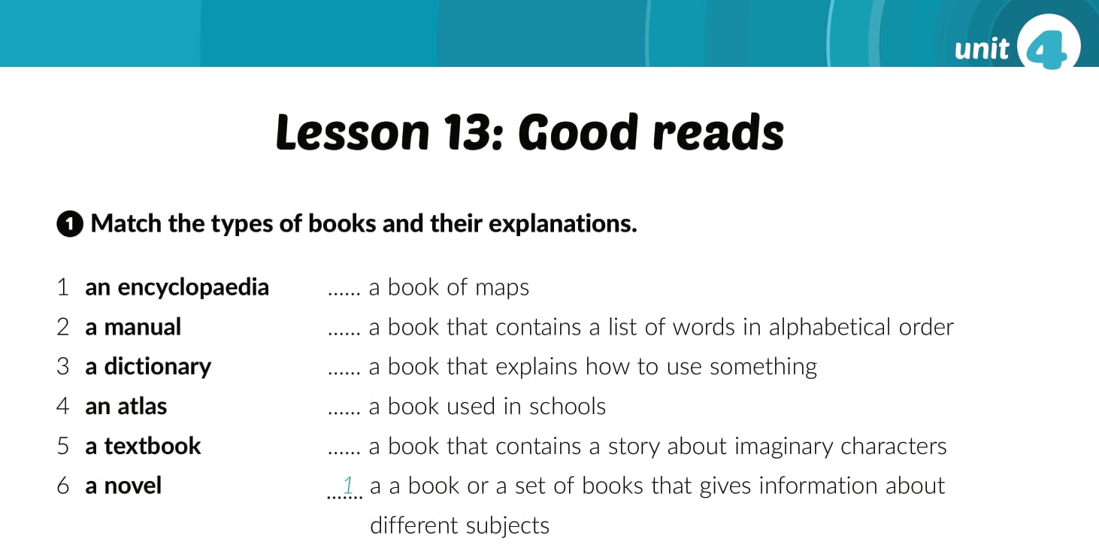
Workbook, page 55.
4
3
2
5
6

Slide 15
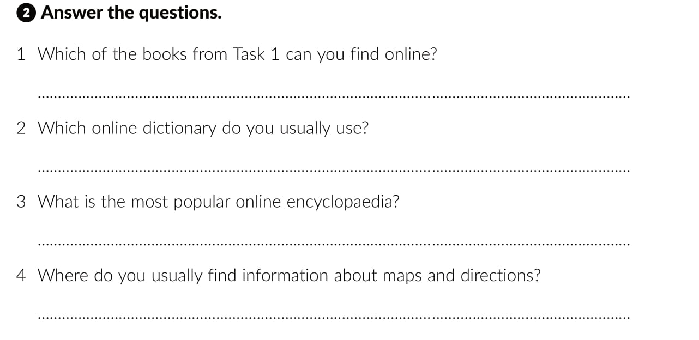
All of them.
Wikipedia.
Google maps.

Slide 16
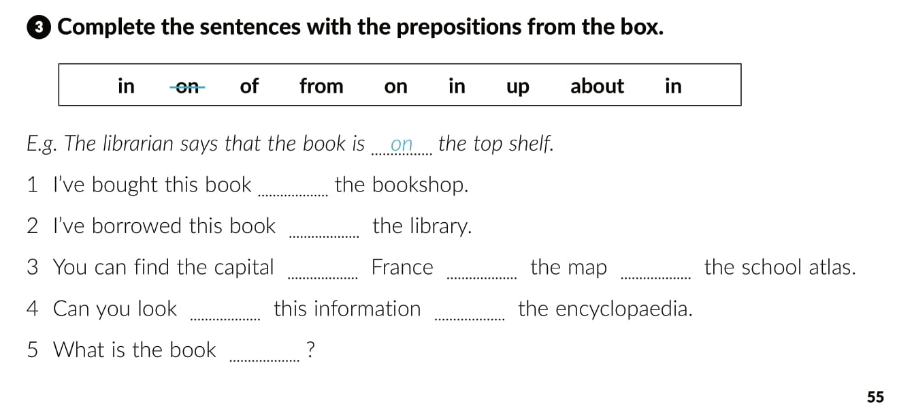
in
from
of
on
in
up
in
about

Slide 17
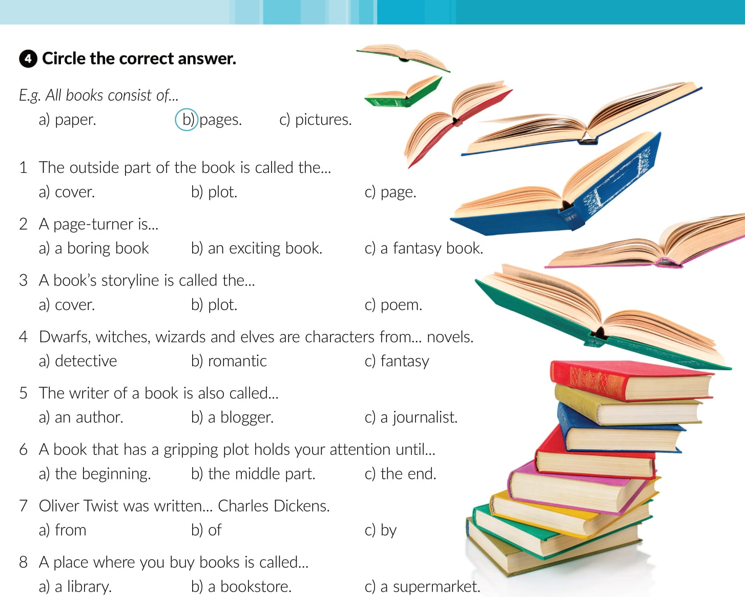

Slide 18
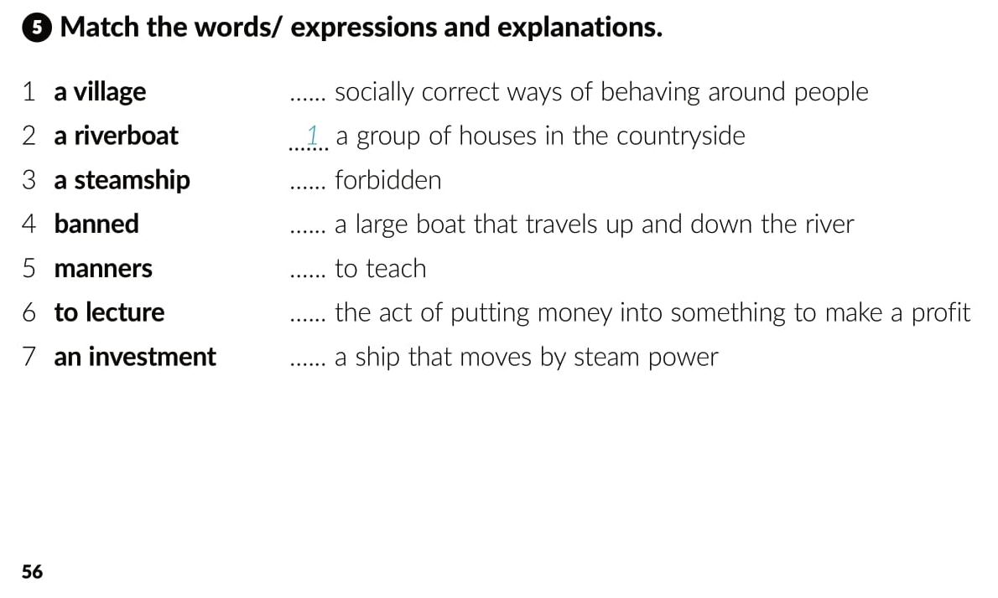
5
4
2
6
7
3

Slide 19
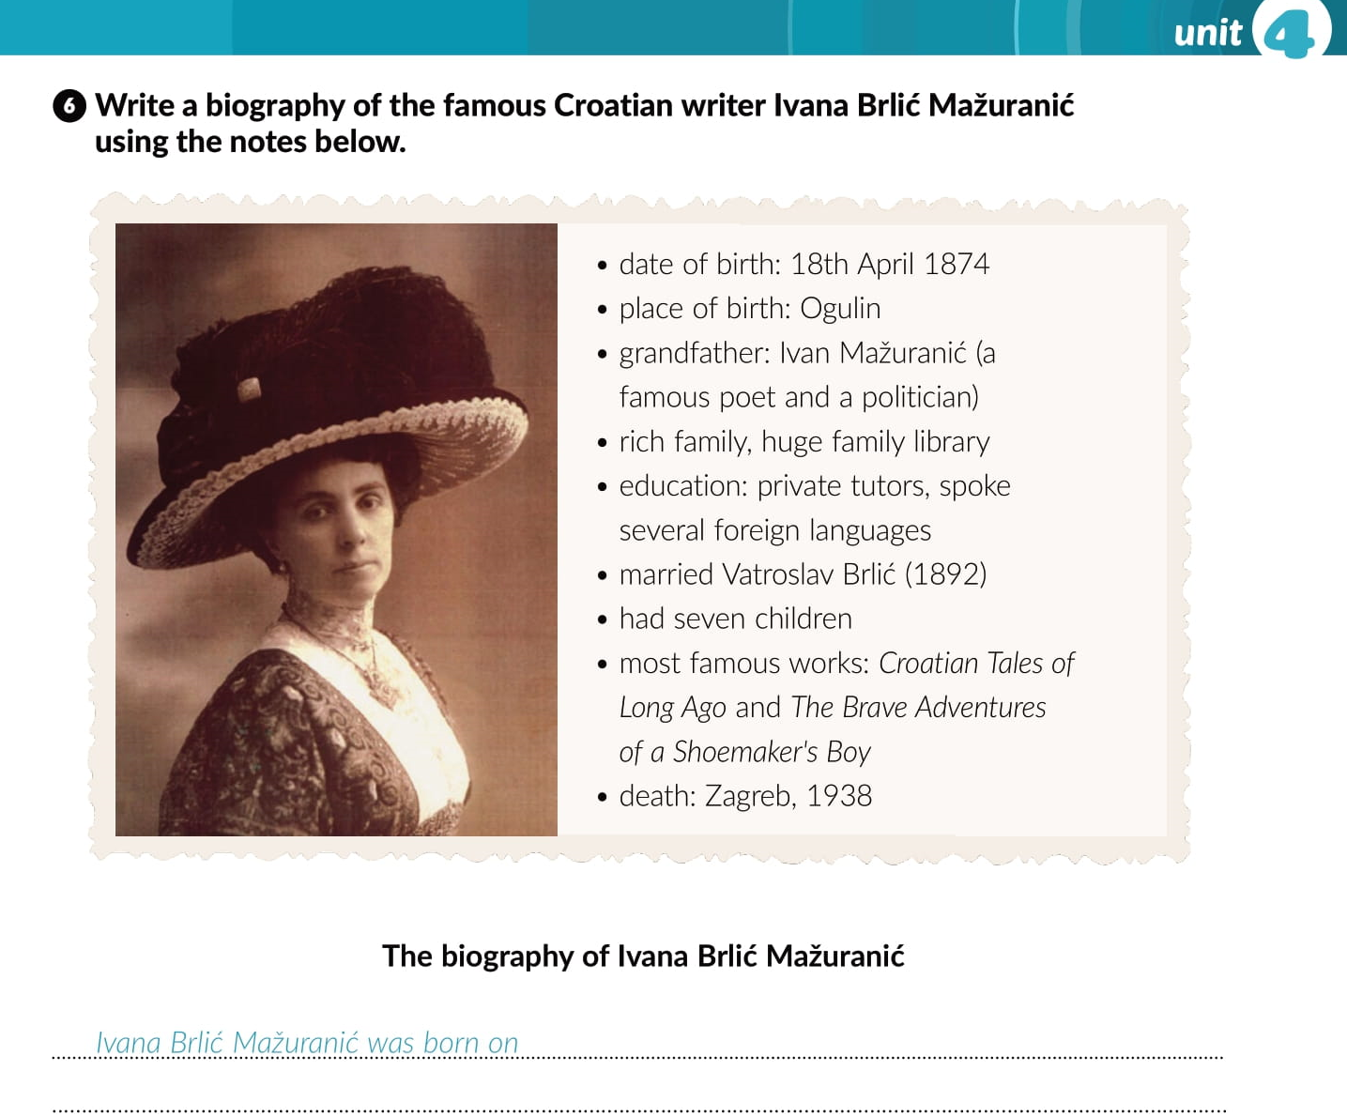

Slide 20
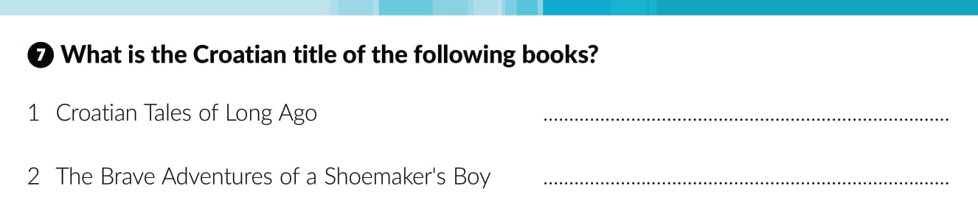



Priče iz davnine
Čudnovate zgode šegrta Hlapića

Slide 21
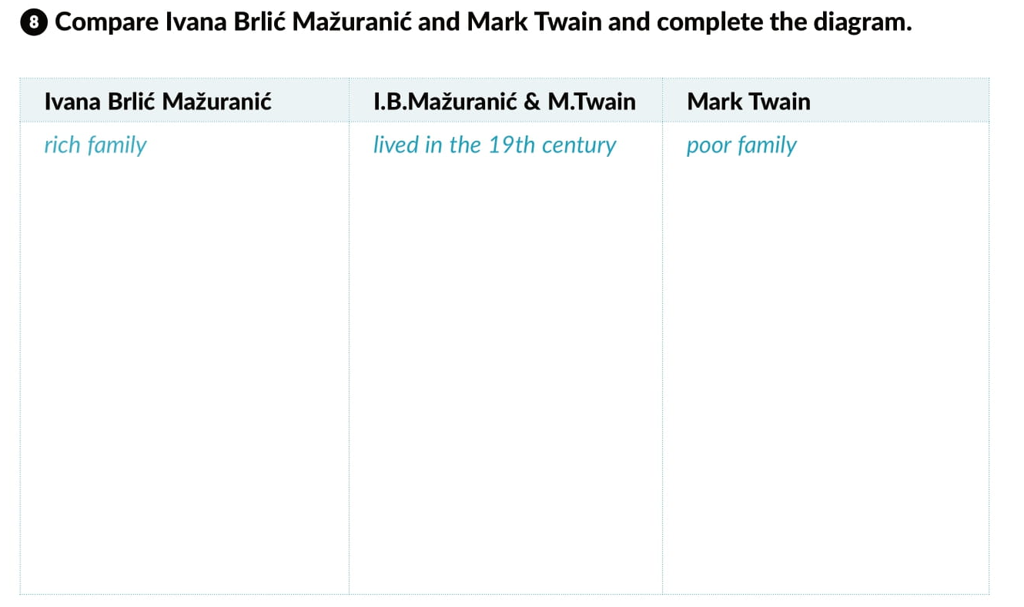
well educated
married and had children
left schoool early
lived in Croatia
published a lot of books
travelled a lot
family person
used pen names
did many different jobs
nominated for the Nobel prize
Mark Twain Prize for humor
was named after him

Slide 22

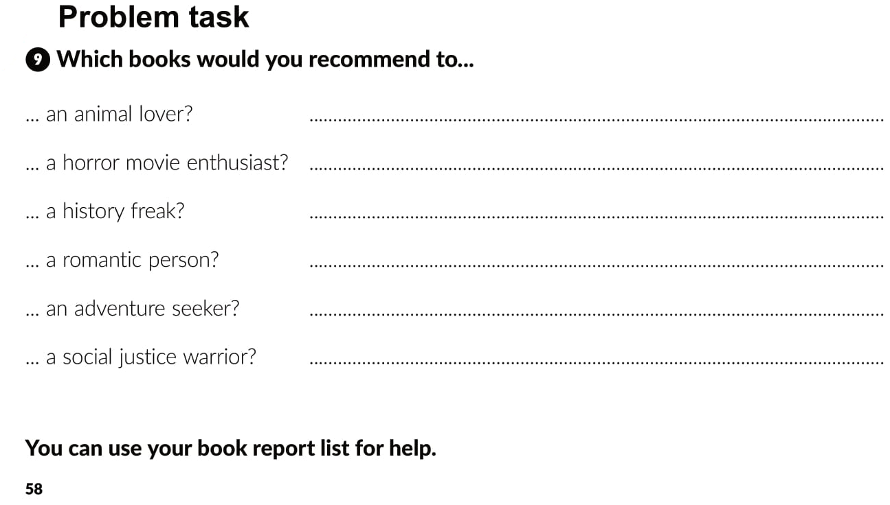

Slide 23

Otvori sljedeću poveznicu, te odaberi PLAY AND LEARN!
Lesson 13 Good reads | Way to go 4 (e-sfera.hr)

